Slide 1
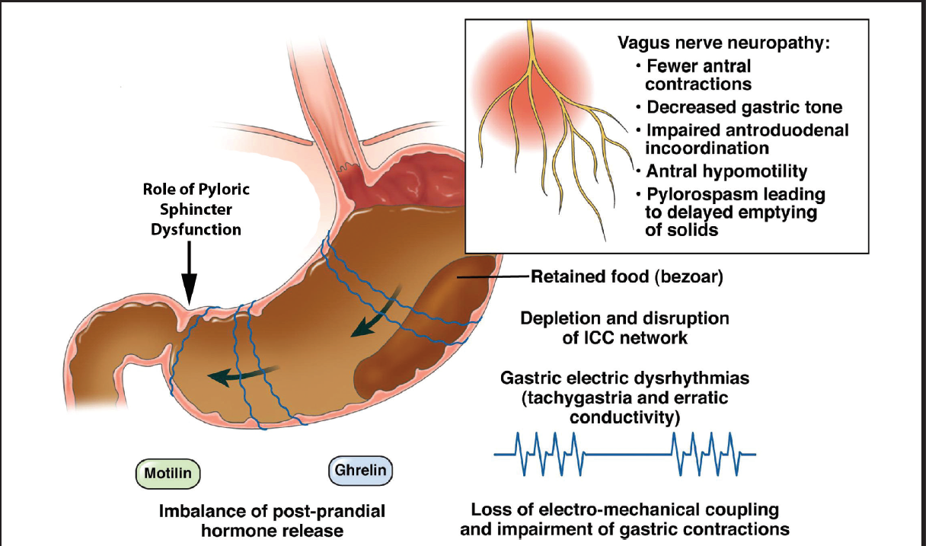
The Prevalence of Delayed Gastric Emptying in Cystic Fibrosis Lung Transplant Recipients
Bridget Schuld, RD, LDN, CNSC; Katherine Young, MD; Erin M Lowery, MD, MS
Loyola University Medical Center
Introduction
Methods
Results
Changes in gastrointestinal function following lung transplantation are common and can lead to various complications, affecting nutritional status and overall morbidity and mortality.¹ Gastroparesis is a condition characterized by delayed gastric emptying (DGE) in the absence of a mechanical obstruction and results in bloating, early satiety, gastroesophageal reflux, nausea, and emesis. Gastroparesis results from a complication of diabetes mellitus, gastrointestinal surgery, neurological disease, collagen vascular disorders, or medications. However, sometimes the etiology is unknown, or idiopathic in nature.²
In the lung transplant population, investigations of gastroparesis are limited and reported prevalence is widely variable, ranging from 23 – 91%. Besides the nutritional manifestations, it is suggested that gastroparesis may lead to worsen lung allograft function.³ However, there is limited literature describing the occurrence of delayed gastric emptying by disease state, and more specifically, in CF lung transplant recipients.
Image obtained from Practical Gastroenterology, April 2017
Adult lung transplant recipients at Loyola University Medical Center transplanted between January 1, 2010 and April 30, 2018 were retrospectively evaluated for DGE using 4-hour gastric emptying scintigraphy (GES) before and after lung transplantation.
Not all patients who received lung transplantation completed this test, only those who were symptomatic.
Gastric emptying tests were completed either by liquid meal or solid meal -phase studies.
GES with solid-phase meal is the standard for diagnosis as it quantifies the emptying of a physiologic caloric meal.⁴
The liquid alternative was used when patients are unable to consume solids.
DGE was defined:
>70% of contents remaining in the stomach at 90 minutes for liquid meals
or
> 10% of contents remaining at 240 minutes for solid meals.
Delayed Gastric Emptying
Diabetes Mellitus
Idiopathic
Autoimmune disease
Post-Surgical
Diseases of extrinsic neural control
Medication
Vagal Nerve Injury
Vagotomy
Upper GI surgeries
μ-opiate receptor agonists
GLP-1 analogs
Cyclosporine
Parkinsonism
Amyloidosis
Scleroderma
Post-Viral
Figure 1. Causes of Gastroparesis
Results
Table 1. Demographics, Clinical Characteristics and GES Results
Pt | Sex | Age | Pre-Tx DM | Post-Tx DM | BMI at Tx | Pre-Tx Tube Feeds | PGD Score 72 hrs | Post-Tx GES Results* 0-6 mos Post-Tx | Days Post-Tx | Post-Tx GES Results* >6 mos Post-Tx | Days Post-GES #1 | Days Post-Tx
Patients with Negative Gastric Emptying Studies
EE | F | 17 | Yes | Yes | 16.2 | Yes | 1 | 3% | 45
LL | M | 24 | Yes | Yes | 16.47 | Yes | 0 | 9% | 49
D | F | 52 | No | Yes | 18.8 | Yes | 1 | 8% | 142
T | F | 37 | Yes | Yes | 23.56 | Yes | 0 |  |  | 3% |  | 181
F | F | 48 | Yes | Yes | 21 | Yes | 3 |  |  | 2% |  | 301
MM | M | 24 | Yes | Yes | 19.7 | Yes | 0 |  |  | 1% |  | 306
Patients with Positive Gastric Emptying Studies
O | F | 22 | No | Yes | 20.74 | Yes | 2 | 8% | 105 | 15% | 144 | 249
G | F | 50 | Yes | Yes | 21.61 | No | 1 | 93% | 70 | 75% | 217 | 287
CC | F | 36 | Yes | Yes | 17.9 | No | 1 | 96% | 59 | 64%- L | 334 | 393
I | F | 44 | Yes | Yes | 18.6 | Yes | 2 | 79% | 43 | 4% | 596 | 639
J | F | 29 | No | Yes | 19.74 | No | 0 | 97%- L | 14
K | M | 29 | No | Yes | 21 | Yes | 3 | 75% | 27
W | M | 37 | No | Yes | 21.97 | No | 1 | 25% | 38
GG | M | 45 | Yes | Yes | 18 | Yes | 1 | 92%- L | 71
E | F | 18 | No | Yes | 17.4 | Yes | 1 | 97%- L | 78 | 76% | 930 | 1008
H | M | 33 | Yes | Yes | 19.5 | Yes | 0 |  |  | 78% |  | 247
II | F | 31 | Yes | Yes | 20.26 | No | 1 |  |  | 37% |  | 282
*Percent remaining at 240 minutes on solid GES or at 90 minutes on liquid (L) GES
Conclusion
Delayed gastric emptying is very common after lung transplantation in patients with CF, affecting a greater percentage than in non-CF lung transplant recipients.
There is a significant improvement in gastric emptying between 12 and 18 months after transplantation.
Future investigations should pursue the effect of delayed gastric emptying in CF on post-transplant outcomes.
References
Objective
1. Berkowitz N, Schulman LL, McGregor C, Markowitz D. Gastroparesis After Lung Transplantation: Potential Role in Postoperative Respiratory Complications. Chest. 1995;108(6):1602-1607. doi:10.1378/CHEST.108.6.1602
2. Tack, J., Carbone, F., & Rotondo, A. (2015). Gastroparesis. Current Opinion in Gastroenterology,31(6), 499-505. doi:10.1097/MOG.0000000000000220
3. Raviv Y, D’Ovidio F, Pierre A, et al. Prevalence of gastroparesis before and after lung transplantation and its association with lung allograft outcomes. Clin Transplant. 2012;26(1):133-142. doi:10.1111/j.1399-0012.2011.01434.x
4. Camilleri, M., Parkman, H. P., Shafi, M. A., Abell, T. L., & Gerson, L. (2013). Clinical Guideline: Management of Gastroparesis. American Journal of Gastroenterology,108(1), 18-38. doi:10.1038/ajg.2012.373
To identify the occurrence of delayed gastric emptying and risk factors that may be associated with the development of gastroparesis in cystic fibrosis patients undergoing lung transplantation.

